Slide 1
Beers and Breweries
By Machine Churning Consulting
Nitin Agarwal
YuMei Bennett

Slide 2
Beers and Breweries
CoBell
Machine Churning
Data Analytics
New Revenue Stream
Machine Churning consulting is honored to be selected for Beers and Breweries data analytic project.
Our mission is to provide business intelligence to convert data into information and knowledge.
Cobell Entertainment with long history and tradition to serve global market and is one of the largest brewery and restaurant corporation in the US.

Slide 3
Project Input and Scope
Looking for new revenue stream!
Through data analytics for recommendations
Two data files input provided
Beers.csv – contains 2410 US craft beers and breweries
Breweries.csv – contains 558 US breweries
https://github.com/tbitxyz/SMU-DDS-Machine-Churning-Project-1

Slide 4
Data Analysis – input data summary
Name | Beer_ID | ABV | IBU | Brewery_id | Style | Ounces
Pub Beer | 1436 | 0.05 |  | 409 | American Pale Lager | 12
Devil's Cup | 2265 | 0.066 |  | 178 | American Pale Ale (APA) | 12
Rise of the Phoenix | 2264 | 0.071 |  | 178 | American IPA | 12
Sinister | 2263 | 0.09 |  | 178 | American Double / Imperial IPA | 12
Sex and Candy | 2262 | 0.075 |  | 178 | American IPA | 12
Black Exodus | 2261 | 0.077 |  | 178 | Oatmeal Stout | 12
Variables | # of NAs
Brew_ID | 0
Beer_Name | 0
Beer_ID | 0
ABV | 62
IBU | 1005
Style | 0
Ounces | 0
Brew_Name | 0
City | 0
State | 0
Brew_ID | Name | City | State
1 | NorthGate Brewing | Minneapolis | MN
2 | Against the Grain Brewery | Louisville | KY
3 | Jack's Abby Craft Lagers | Framingham | MA
4 | Mike Hess Brewing Company | San Diego | CA
5 | Fort Point Beer Company | San Francisco | CA
6 | COAST Brewing Company | Charleston | SC

Slide 5
Data Analysis – Number of Breweries per State
CO | CA | MI | OR | TX | PA | MA | WA | IN | WI | NC | IL | NY | VA | FL | OH | MN | AZ | VT | ME | MO | MT | CT | AK | GA | MD
47 | 39 | 32 | 29 | 28 | 25 | 23 | 23 | 22 | 20 | 19 | 18 | 16 | 16 | 15 | 15 | 12 | 11 | 10 | 9 | 9 | 9 | 8 | 7 | 7 | 7
Please see table above, it is a desending list of states with last column show number of breweries in that state.
Colorado is the winner with 47 breweries, followed by California with 39 breweries.
OK | IA | ID | LA | NE | RI | HI | KY | NM | SC | UT | WY | AL | KS | NH | NJ | TN | AR | DE | MS | NV | DC | ND | SD | WV
6 | 5 | 5 | 5 | 5 | 5 | 4 | 4 | 4 | 4 | 4 | 4 | 3 | 3 | 3 | 3 | 3 | 2 | 2 | 2 | 2 | 1 | 1 | 1 | 1

Slide 6
Data Analysis – IBU & ABV median per State
There are two key variables contributes the classification of type the Beer
Alcohol Content and bitterness
Table of median ABV per state
DC | KY | MI | NM | WV | CO | AL | CT | NV | OK | SD | CA | IL | IN | MD | MS | OH | FL | NC | PA | TN | ID | VA | AK | MN
0.062 | 0.062 | 0.062 | 0.062 | 0.062 | 0.060 | 0.06 | 0.06 | 0.06 | 0.06 | 0.06 | 0.058 | 0.058 | 0.058 | 0.058 | 0.058 | 0.058 | 0.057 | 0.057 | 0.057 | 0.057 | 0.056 | 0.056 | 0.056 | 0.056
NE | OR | IA | WA | AZ | DE | GA | MT | NH | NY | RI | SC | TX | VT | HI | MA | AR | LA | MO | WI | ME | KS | ND | WY | NJ | UT
0.056 | 0.056 | 0.055 | 0.055 | 0.055 | 0.055 | 0.055 | 0.055 | 0.055 | 0.055 | 0.055 | 0.055 | 0.055 | 0.055 | 0.054 | 0.054 | 0.052 | 0.052 | 0.052 | 0.052 | 0.051 | 0.05 | 0.05 | 0.05 | 0.046 | 0.04
TABLE OF MEDIAN IBU STATE
ME | WV | FL | GA | DE | NM | NH | DC | NY | AK | MS | MN | AL | CA | VA | NV | CO | MT | OH | OR | AR | ID | WA | TN | MA
61 | 57.5 | 55 | 55 | 52 | 51 | 48.5 | 47.5 | 47 | 46 | 45 | 44.5 | 43 | 42 | 42 | 41 | 40 | 40 | 40 | 40 | 39 | 39 | 38 | 37 | 35
MI | NE | OK | NJ | UT | NC | IN | TX | ND | KY | LA | IL | PA | SC | VT | CT | MD | IA | MO | RI | HI | WY | AZ | KS | WI
35 | 35 | 35 | 34.5 | 34 | 33.5 | 33 | 33 | 32 | 31.5 | 31.5 | 30 | 30 | 30 | 30 | 29 | 29 | 26 | 24 | 24 | 22.5 | 21 | 20.5 | 20 | 19

Slide 7
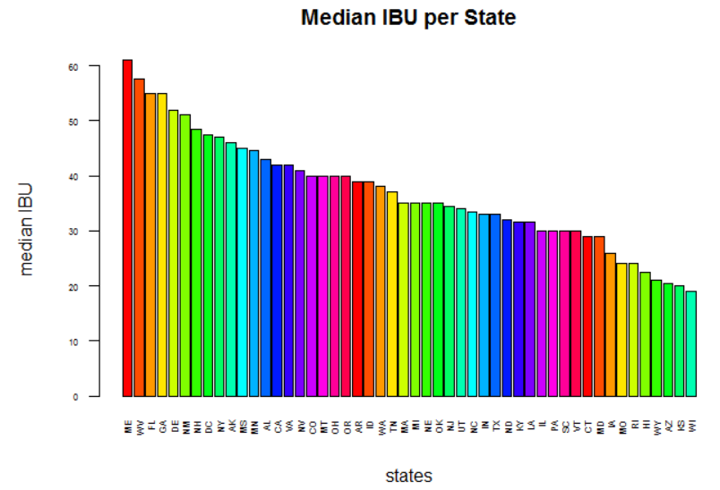

Slide 8
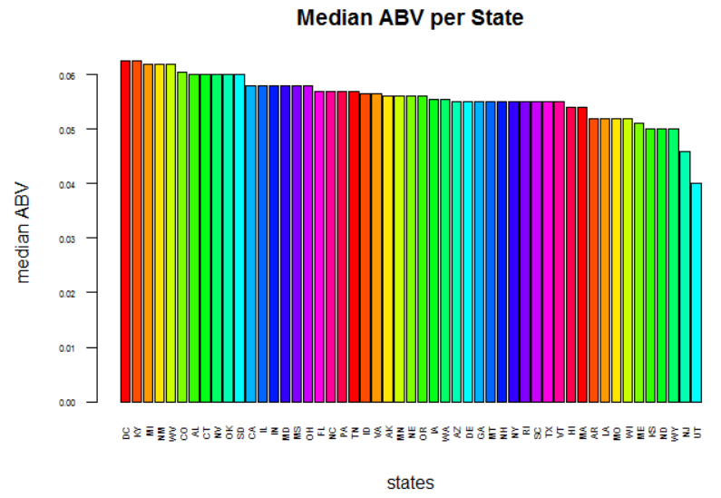

Slide 9
Data Analysis – a deeper look into IBU & ABV
Top AVB breweries
Top IBU Breweries
Brew_ID | Beer_Name | Beer_ID | ABV | IBU | Style | Ounces | Brew_Name | City | State
52 | Lee Hill Series Vol. 5 - Belgian Style Quadrupel Ale | 2565 | 0.128 | NA | Quadrupel (Quad) | 19.2 | Upslope Brewing Company | Boulder | CO
2 | London Balling | 2685 | 0.125 | 80 | English Barleywine | 16 | Against the Grain Brewery | Louisville | KY
18 | Csar | 2621 | 0.12 | 90 | Russian Imperial Stout | 16 | Tin Man Brewing Company | Evansville | IN
52 | Lee Hill Series Vol. 4 - Manhattan Style Rye Ale | 2564 | 0.104 | NA | Rye Beer | 19.2 | Upslope Brewing Company | Boulder | CO
Brew_ID | Beer_Name | Beer_ID | ABV | IBU | Style | Ounces | Brew_Name | City | State
375 | Bitter Bitch Imperial IPA | 980 | 0.082 | 138 | American Double / Imperial IPA | 12 | Astoria Brewing Company | Astoria | OR
345 | Troopers Alley IPA | 1676 | 0.059 | 135 | American IPA | 12 | Wolf Hills Brewing Company | Abingdon | VA
231 | Dead-Eye DIPA | 2067 | 0.09 | 130 | American Double / Imperial IPA | 16 | Cape Ann Brewing Company | Gloucester | MA
100 | Bay of Bengal Double IPA (2014) | 2440 | 0.089 | 126 | American Double / Imperial IPA | 12 | Christian Moerlein Brewing Company | Cincinnati | OH

Slide 10
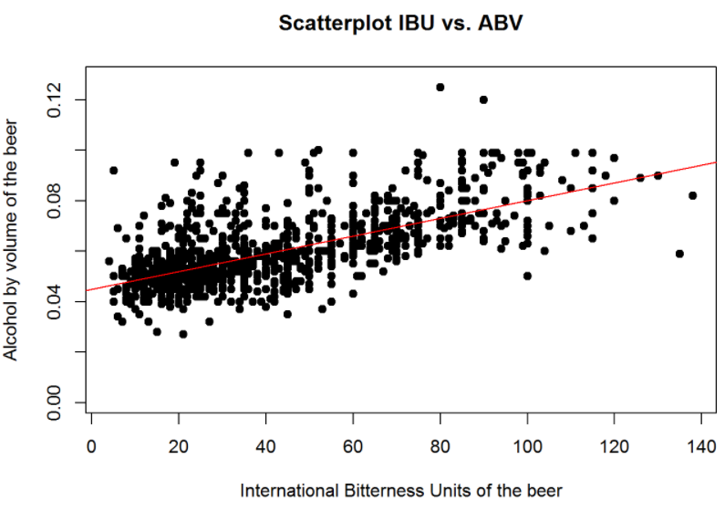
As we can visually observe from the scatter plot and the linear regression line, there is a visible relationship between IBU and ABV. Although the regression line is not steep, but it does show as bitterness increase, there is visible increase on alcohol content as well.

Slide 11
Data Analysis – conclusion
Recommend to create new beer brand with high bitterness and high alcohol content
Recommend to add breweries/restaurant in state of IN, IL
from academic stand point, the analysis was done on observation data provided. Given we have not validated how the data is collected and its validity, we can only say that the result applies to data input population.
From practical stand point, we assume input data are valid from client and it does represent overall market situation, it is a good random collections of data sample. Therefore, analysis result is valid.

